Slide 1




ECB1204 – ANALOG INTEGRATED CIRCUIT DESIGN LIGHT SENSITIVE ALARM USING IC555
Presented by:
RAMANATHAN P(230381171062086) RAHAMATHULLA A(230381171062083) THARUN KUMAR M (2303811710621114)
Under the Guidance of Mrs.G.KEERTHANA, M.E .,
ASSISTANT PROFESSOR
ECE

Slide 2


OUTLINE
ABSTRACT
INTRODUCTION
OBJECTIVE
HARDWARE MODULE
RESULTS AND DISCUSSION
ADVANTAGES AND APPLICATIONS
CONCLUSION
FUTURE ENHANCEMENT

Slide 3
ABSTRACT
The Light Sensitive Alarm is a simple and cost-effective project designed to detect changes in light intensity and trigger an alarm.
It uses an LDR to sense light variations, a 555 Timer IC for signal processing, and outputs like an LED and buzzer for alerts.
The system is ideal for applications in security, light failure detection, and automation, offering a practical solution with low power consumption and ease of implementation.

Slide 4
INTRODUCTION
Designed to monitor and respond to light intensity changes.
LDR senses light; 555 Timer processes signals.
Provides both audio (buzzer) and visual (LED) alerts.
A practical example of basic electronic automation.
Useful for security systems, automation, and educational purposes.

Slide 5
PROBLEM STATEMENT
Need for a simple light-sensitive alarm system.
Existing solutions are costly and complex.
Requires a low-cost and user-friendly design.
Must be energy-efficient for portable use.

Slide 6
OBJECTIVE
To Create a simple, efficient light-based alert mechanism.
To develop a low-cost, efficient, and portable alarm system that reacts to changes in light intensity.
It aims to showcase the functionality of the IC 555 timer in practical scenarios and provide insights into the use of light-sensitive components, emphasizing their
importance in automation and security

Slide 7
HARDWARE MODULE
IC 555 Timer: Core of the circuit, configured in monostable or astable mode.
LDR (Light Dependent Resistor): Senses ambient light levels.
Buzzer: Produces an alarm when triggered.
LED: Visual indicator of light detection.
Resistors.
Pull-down resistors for stable operation.
Voltage divider for LDR circuit.
Capacitor: Stabilizes IC 555 operation.
Power Source: Typically 9V DC battery.

Slide 8
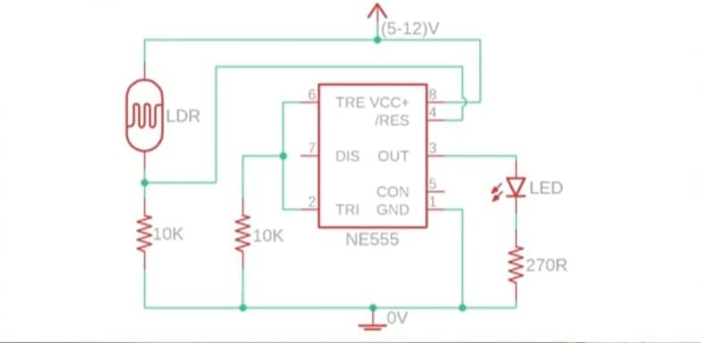
CIRCUIT DIAGRAM
12/3/2024

Slide 9
RESULTS AND DISCUSSION
The constructed circuit reliably detects changes in ambient light levels and produces a corresponding alarm through the buzzer and LED.
The sensitivity of the system can be finely tuned by adjusting the resistance values in the LDR-voltage divider network.
The delay and response time of the alarm system are determined by the resistor- capacitor configuration connected to the IC 555.
Experimental testing under different lighting conditions revealed that the circuit is capable of consistently detecting changes, making it suitable for a wide range of applications, including security and automation.

Slide 10
ADVANTAGES AND APPLICATIONS
Advantages:
The light-reactive alarm circuit is simple to design and implement, making it accessible to students and hobbyists.
It is cost-effective due to the minimal number of components required, and its
energy-efficient design ensures that it operates for extended periods on a small power source.
The circuit's small size and portability make it versatile for various applications.

Slide 11
Applications.
This circuit can be applied in security systems to detect unauthorized entry by sensing changes in light levels.
It can also be used in home automation to trigger alerts when specific lighting conditions are met.
The circuit serves as an excellent educational tool for demonstrating the principles of light-sensitive electronics and the operation of IC 555 timers.

Slide 12
CONCLUSION
Effective for small-scale security and automation purposes.
Offers a practical, low-cost solution for basic applications.
The light-reactive alarm is an efficient, easy-to-build system for detecting changes in ambient light.
It leverages the IC 555 timer’s versatility, providing reliable performance for various applications.

Slide 13
FUTURE ENHANCEMENT
Add microcontrollers for more precise control.
Incorporate wireless alert systems (RF/IoT).
Develop a solar-powered version for sustainability.
Combine with motion sensors for enhanced security. Adding wireless modules for remote alarm signaling.
Enhanced sensitivity with modern photoresistors or photodiodes.

Slide 14

THANK YOU

